Slide 1
Lipid Transport

Slide 2
Quiz Question #1
What dietary factor is most associated with increased LDL cholesterol?
Saturated fatty acids
Monunsaturated fatty acids
Polyunsaturated fatty acids
Fiber

Slide 3
Quiz Question #2
What does reverse cholesterol transport refer to?
Transport of cholesterol from the gut lumen to the liver
Transport of cholesterol from the liver to the periphery
Transport of cholesterol from the periphery to the liver
Transport of cholesterol within cells to nascent VLDL particles

Slide 4
Quiz Question #3
Lipolysis is inhibited by…
Adrenaline
Glucagon
Insulin
Cortisol

Slide 5
This is the last metabolism lecture!
Reflect on something you learned this semester related to nutrient biochemistry, and write on a cue card how you could explain this to someone who is asking you about something nutrition related.
We will collect these cue cards at the end of class.
Some ideas if you are stuck:
Fructose or glucose, is there a difference?
What are medium chain triglycerides?
What exactly is fiber?
Why do we need to eat protein?
What does vitamin B1 actually do? (PDH)
Why are there more calories in fat?
Can I eat only cabbage all the time?
How does a ketogenic diet actually work?
What is the difference between Kwashiorkor and Marasmus? What causes this?
Why do some people need choline and some don’t?
What is DHA/EPA and why is Costco selling it to me?

Slide 6
Learning Objectives
Explain why lipoproteins are necessary for triglyceride and cholesterol transport.
Describe the main carriers of cholesterol and triglyceride throughout the body, including how their apolipoproteins affect their endocytosis or catabolism.
Apply your knowledge of cholesterol transport to explain why someone may have changes in HDL and LDL levels.
Understand the etiology of high cholesterol and its potential role in atherosclerosis.
Apply your understanding of cholesterol absorption, synthesis and transport to evaluate the relationships between dietary cholesterol and triglycerides and cardiovascular risk.
Explain the role of lipoprotein lipase in lipid transport, including how it is regulated.

Slide 7
Triglycerides from Chylomycrons and VLDL

Slide 8
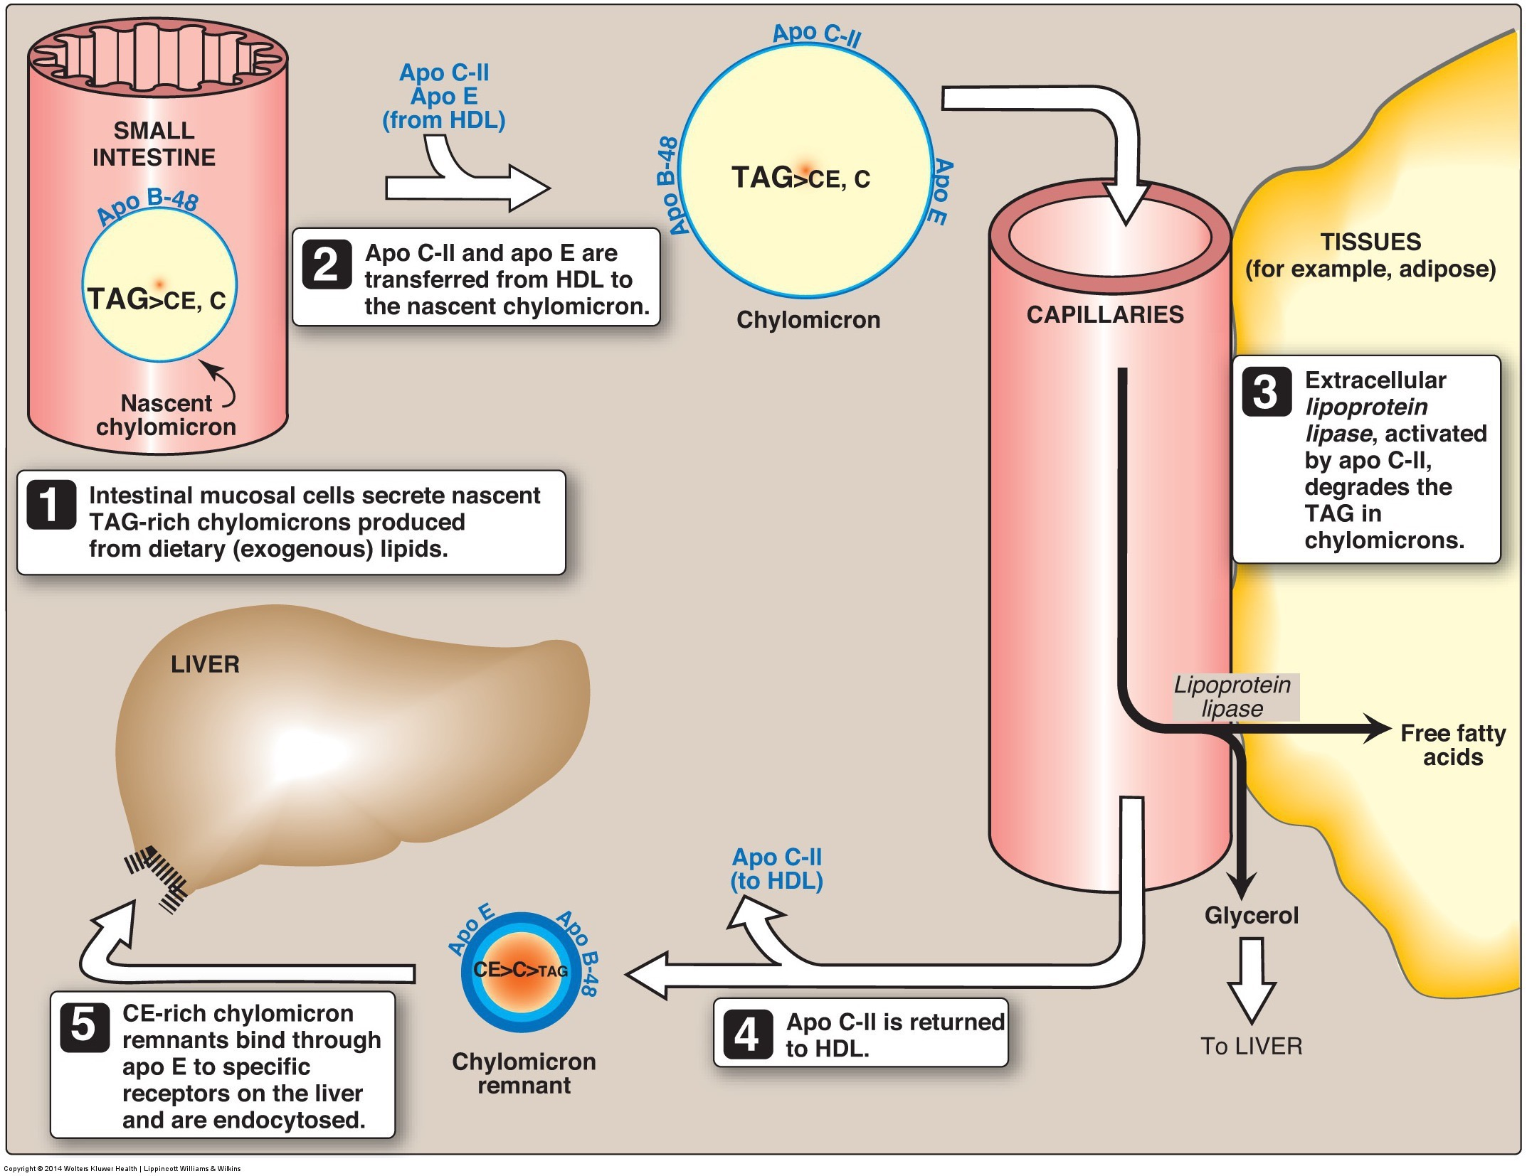
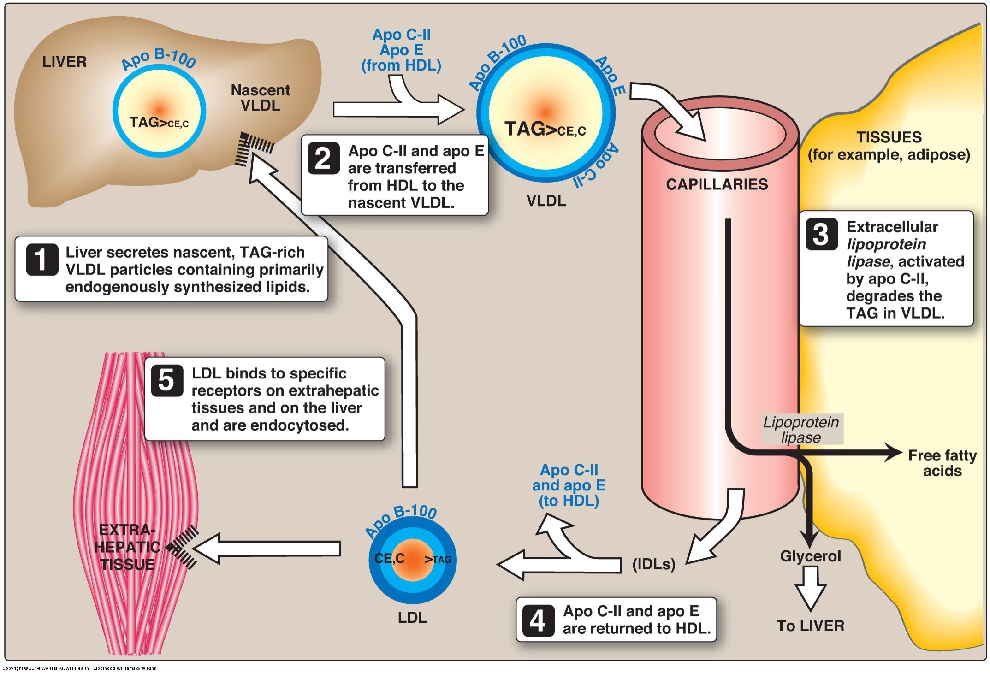
Lipid Transport from Liver
Mainly synthesized in liver and adipose tissue
Small amount from de novo lipogenesis
Primarily fatty acids from dietary fat
In the liver triglycerides and cholesterol are synthesized, then packaged for transport to adipose tissue via VLDL

Slide 9
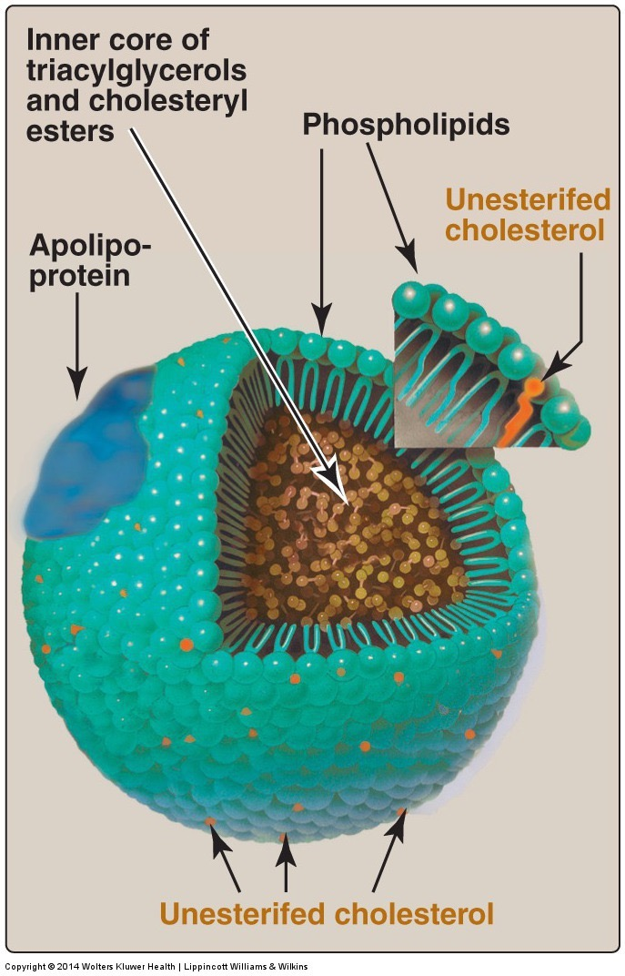
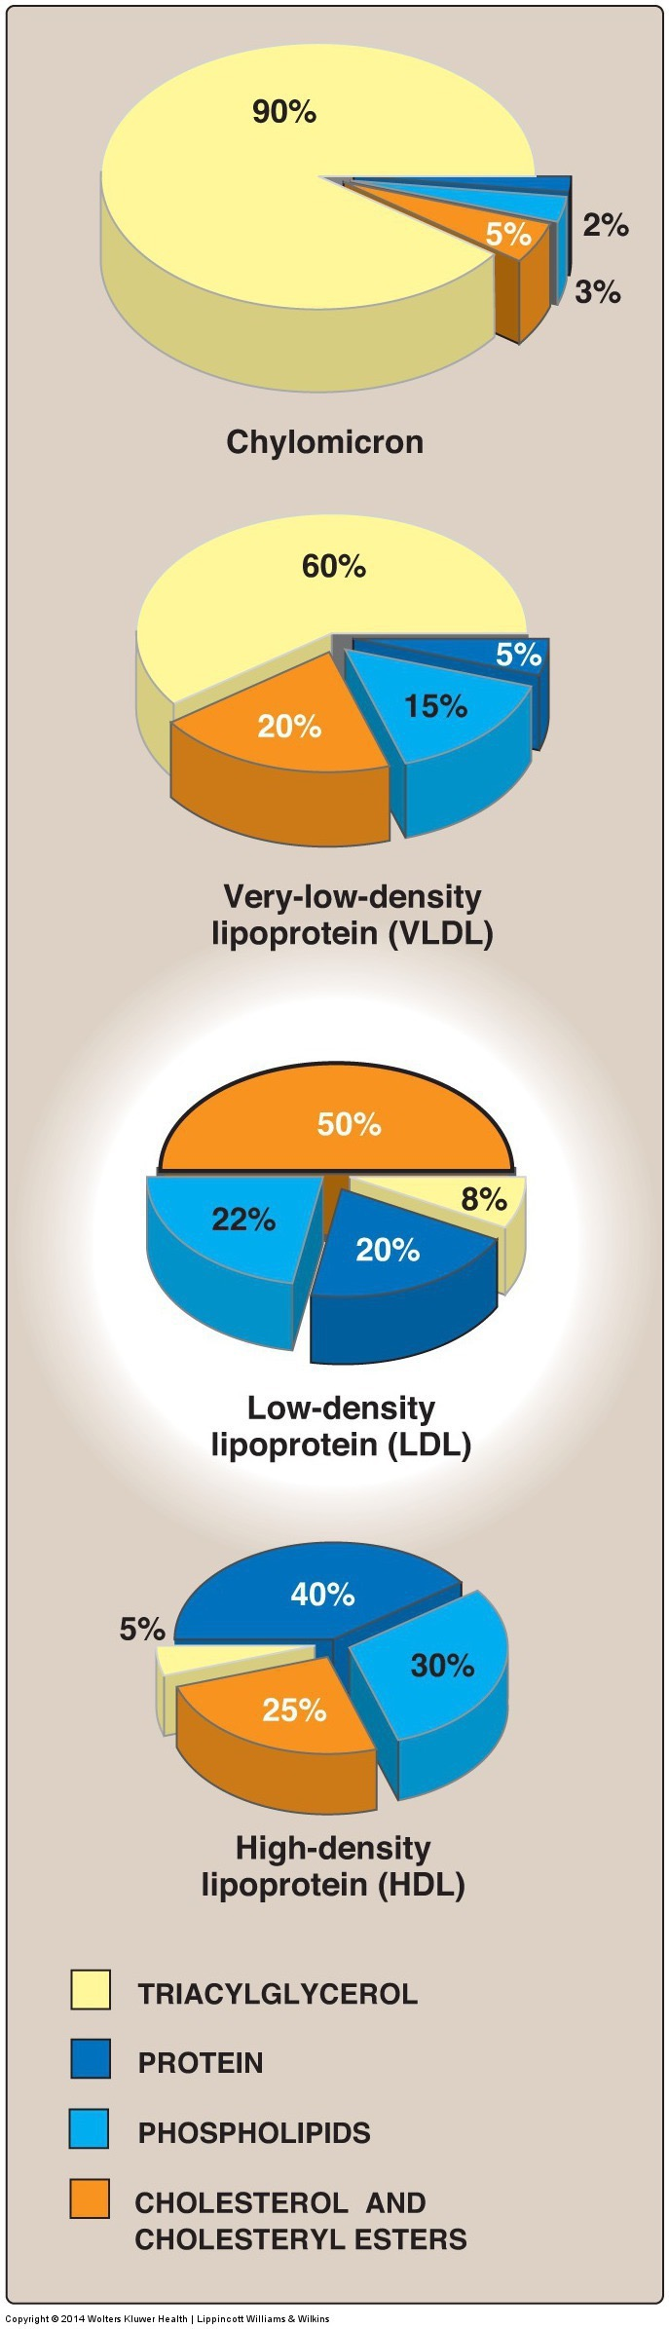
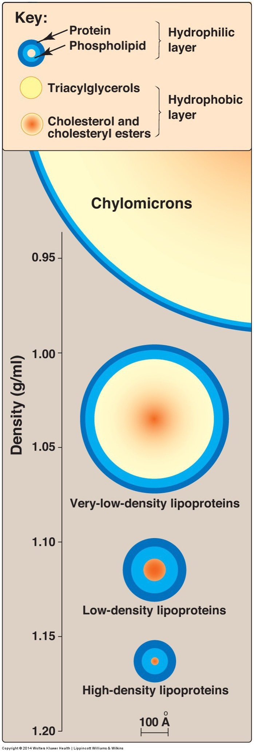
Lipoprotein Particles and Composition

Slide 10
Lipoprotein Particle Summary
Class | Composition | Apolipoproteins
Chylomicron | Mainly TG | A-V, B-48, C-II, C-III, E
Chylomicron Remnant (CR) | Mainly Cholesterol | B-48, E
VLDL | Mainly TG | A-V, B-100, C-II, E
IDL | TG/Cholesterol | B-100, E
LDL | Cholesterol | B-100
HDL | Empty | A-I, A-II, E
Receptor | Particle | Ligand | Tissues
LDLR | LDL, CR (poor) | B-100/48, E | Liver
SR-BI | HDL | B-100 | Liver
LPL | Chylomicron/VLDL | CII | Peripheral
ApoA1 activates LCAT
CII activates Lipoprotein Lipase
CIII inhibits Hepatic Lipase and Lipoprotein Lipase
Notes:
CII lost as triglycerides are depleted

Slide 11
Production of VLDL by the Liver

Slide 12
Why might a choline-deficient diet cause fatty liver disease?
Choline is important for lipolysis
Choline is important for beta oxidation
Choline is important for HDL uptake
Choline is important for VLDL production

Slide 13
Fatty Acids are Liberated from TG by Lipoprotein Lipase in Most Tissues
LPL highly expressed in heart, muscle, fat
Secreted by cells to ECM
Activated by Apolipoprotein on Chylomicron/VLDL (ApoCII)

Slide 14
Nutritional Control of Lipoprotein Lipase Through Angptl4
Daniella Youhan
NUTR 630

Slide 15
Quick Overview
Fatty acids are transported through the blood as triglycerides within chylomicrons and VLDLs
Interact with LPL to form free fatty acids
Taken up by cells for storage or oxidation
Balance between fatty acid uptake and tissue demand is important
Imbalance can lead to cellular lipid overload
Feature in metabolic disorders

Slide 16
Lipoprotein Lipase (LPL)
Primarily Tissues
Heart, skeletal, muscle, and adipose
Produced by parenchymal cells
Released into sub-endothelial space
Transported and anchored to the lumen side of the capillary endothelium
Essential role is to clear plasma triglycerides
Mainly controlled by post-translational mechanisms

Slide 17
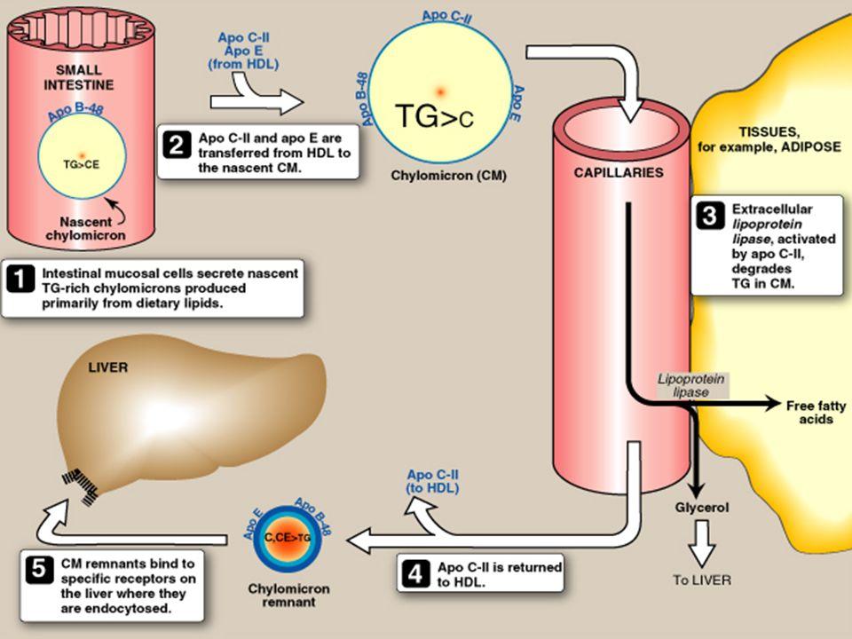

Slide 18
Angiopoietin-like 4 (Angptl4)
Under transcriptional control by fatty acids levels and PPARs
Angiopoietin-like proteins inhibit LPL activity
Influences plasma triglyceride levels
Tissue expression overlaps with LPL
Linked to stimulation of lipolysis during fasting

Slide 19
Regulation of LPL By Angptl4
Facilitated through cleaving of Angptl4
Releases Angptl4 from the cell surface & increases function
Overexpression of the protein:
Significantly increases plasma triglyceride levels
Lowers LPL activity
Deletion of the protein:
Lowers plasma triglyceride levels
Elevated LPL activity
LPL & Angptl4 are regulated by changes in nutritional state specific to each individual tissue

Slide 20
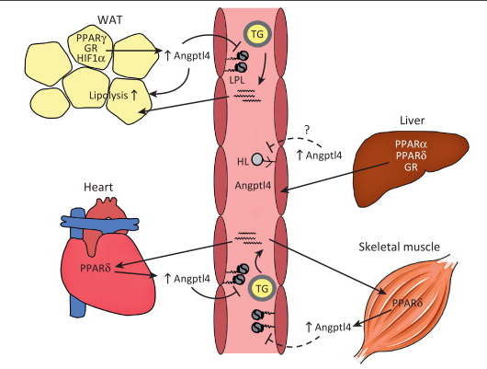

Slide 21
Regulation of LPL By Angptl4 During Fasting
LPL activity is decreased during fasting states
Initiated by Angptl4
Lack of Angptl4 results in extremely low plasma triglyceride levels during fasting
Overexpression of Angptl4:
Reduced uptake of fatty acids into adipose tissue
Elevated plasma triglyceride levels
Angptl4 main role is to ensure triglycerides are distributed in adequate and proper amounts

Slide 22
Angptl4 & Coronary Heart Disease
Significant association between CHD and Angptl4 mutations
Carriers of the gene mutation has triglyceride levels that were 35% lower than that of people with normal gene
Found mutations in LPL that also increased risk of CHD in people who had the Angptl4 mutation

Slide 23
Summary
Chylomicrons and VLDLs distribute fatty acids to various tissues by interacting with the enzyme LPL
The protein Angptl4 is under transcriptional control by fatty acids
Angptl4 works to inhibit LPL activity and reduce lipid storage.
Angptl4 main role is to ensure triglycerides are distributed in adequate and proper amounts to different tissues during different nutritional states.
Accomplished through regulation of LPL
More research needs to be done to fully understand the interaction, interaction location, and co-secretion of the lipase and protein

Slide 24
References
Dijk, W., & Kersten, S. (2014, March). Regulation of lipoprotein lipase by Angptl4. Trends in
Endocrinology and Metabolism, 25(3), 146-155.
Drs. N. Stitziel, N., Stirrups, K., Masca, N., Erdmann, J., Kathiresan, S., Deloukas, P., Samani, N.J., &
Schunkert, H. (2016, March 24). Coding Variation in ANGPTL4, LPL, and SVEP1 and the Risk of Coronary Disease. The New England Journal of Medicine, 372(12), 1134-1144.

Slide 25
Mutations in VLDL/LPL System
https://twitter.com/skathire/status/839151207436419072

Slide 26
Cholesterol Synthesis and Transport

Slide 27
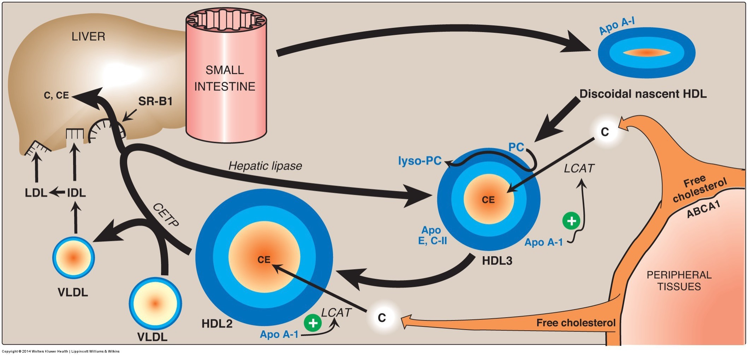
Retrieval of Cholesterol from Tissues
HDL oaks up cholesterol from other tissues
Taken up by liver via LDLR or SR-B1

Slide 28
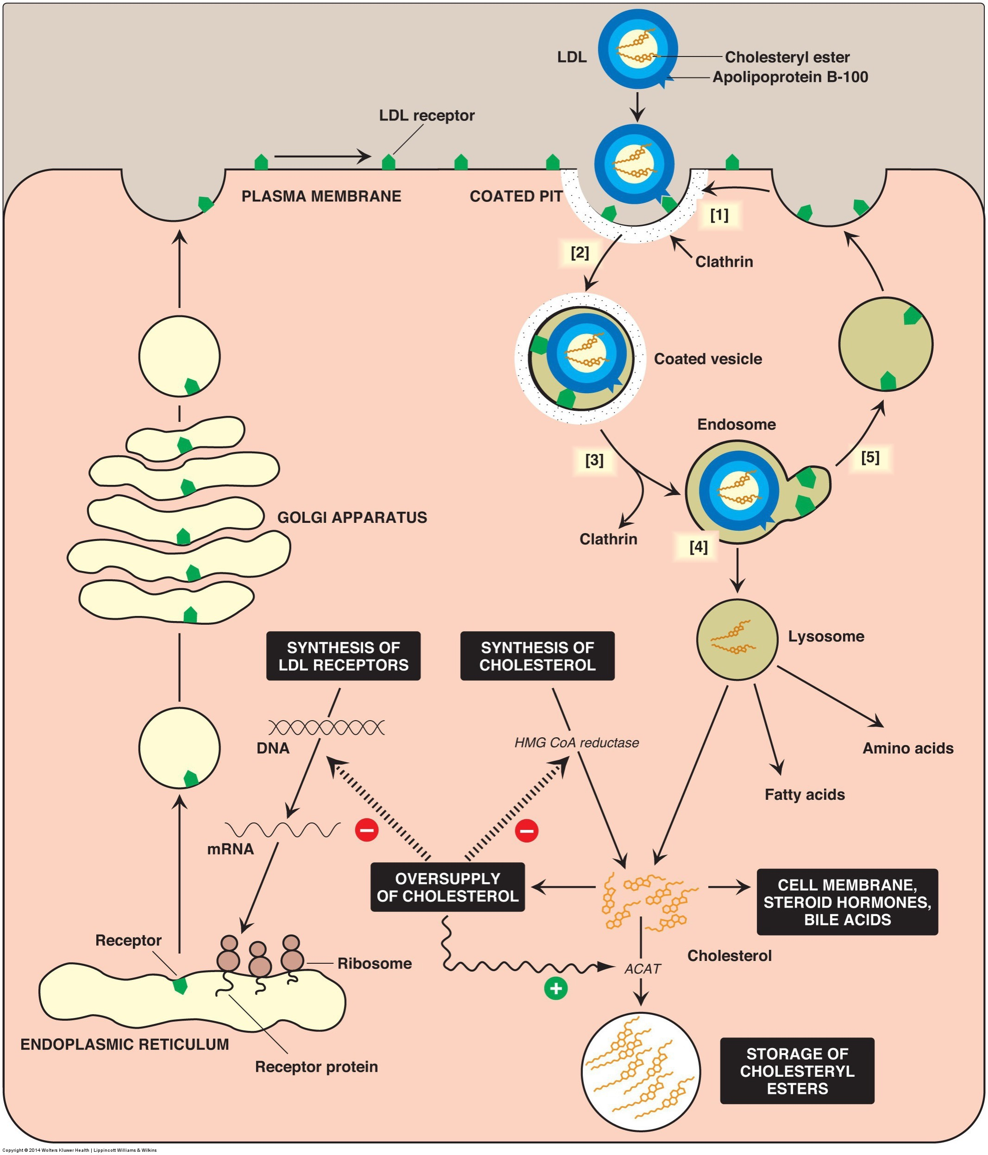
Regulation of LDL Uptake in the Liver
LDL from
Depleted VLDL
Cholesterol rich HDL
High hepatocyte cholesterol
Inactivation of SREBP2
Less LDL Receptors
Less HMGCR

Slide 29
Thought Experiment
If you had a mutation of LDLR
What would happen to LDL levels in the blood?
What would happen to inter-hepatocyte cholesterol levels?
What would happen to SREBP2 activity?
How would that affect cholesterol synthesis?
Would that alleviate or exacerbate hypercholesterolemia?

Slide 30
LDLR Mutations
Physiological outcomes:
Altered synthesis of LDLRs results in abnormal levels and functioning of receptors at cell membrane
Accelerated biosynthesis of cholesterol – HMG CoA reductase remains activated
Results in high LDL levels in blood
Diet can be contributing factor to high serum LDL
Controlled by drugs, dietary restrictions, exercise
Statins - class of drugs inhibiting HMG CoA reductase

Slide 31
LDLR Mutations
Cells unable to bind LDL via LDLRs (mutant cells)
Mutant cells – defect of chromosome 19
110 mutations effecting differing domains of LDLR
Broad term called Familial Hypercholesterolemia
1 in 500 carry at least one mutation
Emily C. O’Brien, PhD, et al. Rationale and design of the familial hypercholesterolemia foundation CAscade SCreening for Awareness and DEtection of Familial Hypercholesterolemia registry. American Heart Journal. 167:3. March 2014

Slide 32
LDL Differences and Cardiovascular Events

Slide 33
The relationship between dietary and serum cholesterol levels
Di Liu

Slide 34
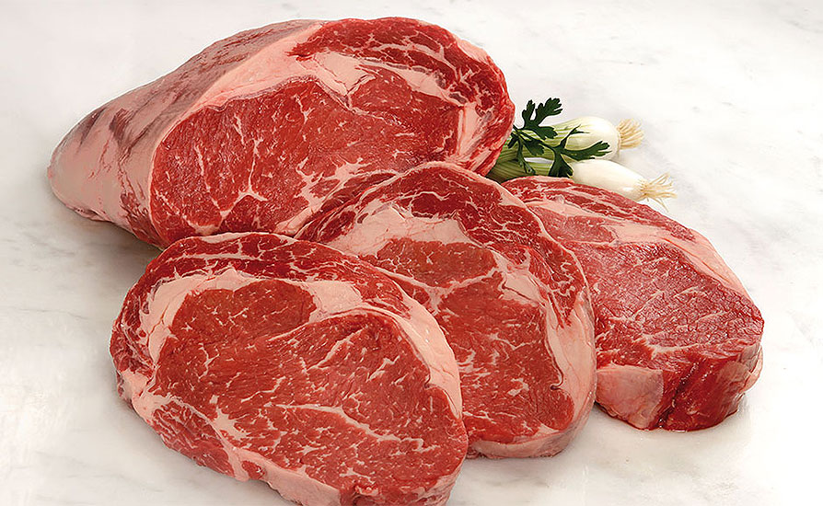
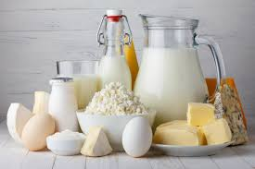

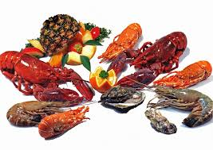
What is cholesterol?
A soft, fat-like substance found in the blood and in all the body’s cells.
Resources
Endogenous
Be synthesized by most tissues (liver)
Dietary
Egg yolk
Meat
Poultry
Full-fat dairy products
Shellfish

Slide 35
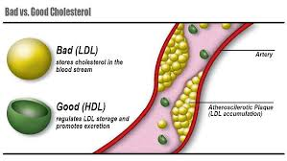
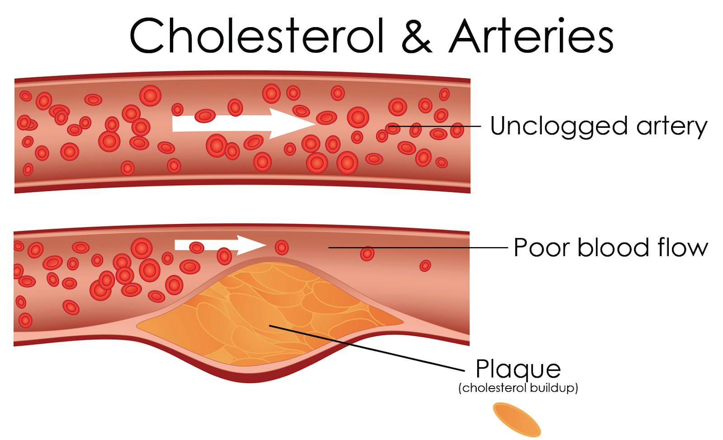
Cholesterol and cardiovascular diseases
Two types of lipoproteins:
LDL-“bad” cholesterol: fatty buildups in arteries
HDL-“good” cholesterol: scavenger of bad cholesterol
Atherosclerosis/heart attack/stroke:
High level of serum cholesterol
Thick and harden plaque
Narrow the arteries
Restrict blood flow

Slide 36
Controversy
The 2010 Dietary Guidelines for Americans:
Maintaining normal blood cholesterol levels: consuming less than 300 mg per day
Individuals at high risk of cardiovascular disease: consuming less than 200 mg per day
VS
The 2015-2020 Dietary Guidelines:
Not including limit consumption of dietary cholesterol to 300 mg per day
Removal of the restriction on the percentage of calories from total fat
The European countries, Australia, Canada, New Zealand, Korea and India do not have an upper limit on cholesterol intake but focus on controlling the intake of saturated and trans fat.

Slide 37
Explanations
Saturated and trans fats
Dietary saturated fatty acids increase cholesterol synthesis and fecal steroid excretion in healthy men and women.
The potential negative effects of dietary cholesterol are relatively small compared to those of saturated and trans fatty acids.
The 2010 USDA Food Patterns are limited in cholesterol because of the commonality of food sources of saturated fats and dietary cholesterol.
A few foods, notably egg yolks and some shellfish, are higher in dietary cholesterol but not saturated fats.
Genetic factor
Hyperresponders
Dietary cholesterol raises blood LDL cholesterol levels
Only 25% of the population

Slide 38
Explanations
No relationship between dietary cholesterol and CHD events.
A lack of association between egg intake and blood cholesterol levels as well as CHD incidence.
Positive associations between CHD mortality and saturated fat, no correlations were found with dietary cholesterol.
One egg per day contributes less than 1% to CHD mortality.
When endogenous cholesterol levels are high, dietary cholesterol absorption is reduced.
Not used for energy
Bile-mediated secretion
Components of bile acid
Taken from circulation

Slide 39
References
About Cholesterol. American Heart Association. Accessed from: http://www.heart.org/HEARTORG/Conditions/Cholesterol/Cholesterol_UCM_001089_SubHomePage.jsp
USDA and US Dsepartment of Health and Human Services. Dietary guidelines for Americans. 7th ed. 2010. Washington (DC): US Government Printing Office; 2010.
Expert Dyslipidemia Panel of the International Atherosclerosis Society Panel members. An International Atheroslerosis Society Position Paper: global recommendations for the management of dyslipidemia—full report. J Clin Lipidol 2014;8:29-60.
McNamara DJ. Dietary cholesterol and atherosclerosis. Biochim Biophys Acta 2000;1529:310-20.
Fernandez ML. Rethinking dietary cholesterol. Curr Opin Clin Nutr Metab Care. 2012 Mar;15(2):117-21. doi: 10.1097/MCO.0b013e32834d2259.
Okuyama H, Ichikawa Y, Sun Y, et al. The cholesterol hypothesis, its basis and its faults. World Rev Nutr Diet 2007; 96:1-17.
Frank B. Hu, Meir J. Stampfer, Eric B. Rimm, JoAnn E. Manson, Alberto Ascherio, Graham A. Colditz, Bernard A. Rosner, Donna Spiegelman, Frank E. Speizer, Frank M. Sacks, Charles H. Hennekens, Walter C. Willett. A Prospective Study of Egg Consumption and Risk of Cardiovascular Disease in Men and Women. JAMA.1999;281(15):1387–1394. doi:10.1001/jama.281.15.1387

Slide 40

Thanks!

Slide 41
Cholesterol and Cardiovascular Risk
Seven Nations Study – Ancel Keys
Cholesterol rises in proportion to saturated fat
Coronary events rose in proportion to serum cholesterol
13 fold higher in Finnish Forresters (270 mg/dL) than Japanese Fisherman (165 mg/dL)
Further studies linked cardiac risk to high LDL and low HDL
Recently challenged by the PURE study, still an active area of controversy

Slide 42
Lipid and CVD Risk – Atherosclerosis
Macrophages contain scavenger receptors
Receptors can bind oxidized LDL and LDL
Macrophage internalizes LDL
Platelets, cellular debris, calcium too
Build-up of LDL inside of macrophage results in foam cell
Foam cell accumulate in blood vessel (plaque buildup)
Thickening of vessel wall
Results in occlusion of blood vessels

Slide 43
PURE Study Results

Slide 44
Previous Studies vs PURE
 | Framingham/MCHS/NHS/HPFS | PURE
Participants | Americans (Mass or Minn) | Global, 18 countries
SES/Lifestyle Variability | Low | High
Ease of Adjusting for | Easier | Harder
Effect of SF on LDL | Increase | Increase
Effects of SF on CVD | Increase | Decrease
Big questions that are raised
Does LDL always associate with CVD risk?
Are there biological ethnic differences that we had missed?
Does PURE sufficiently account for lifestyle factors

